Slide 1


Slide 2
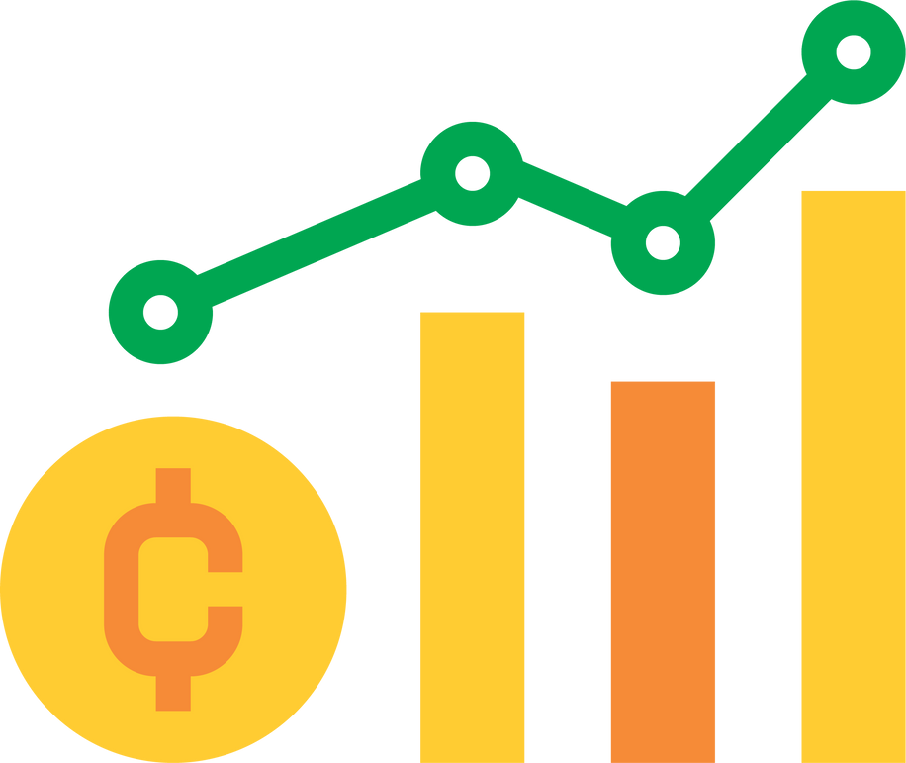
INTRODUCTION
PROJECT OVERVIEW:
A web based platform for managing cryptocurrency portfolios and investments.
It provides dynamic dashboards and real time data visualization.
OBJECTIVE:
Simplify cryptocurrency investments for users with real time insights.

Slide 3

MILESTONE WISE IMPLEMENTATION
Weekly Modules
Module 1
Module 4
User Authentication and Registration
02
Dashboard
03
Module 2
Safe
Crypto
Stocks
Module 5
Portfolio Management Interface
06
Budget
04
Module 3
Module 6
05
Stock Market Data and visualization.
Learning Resources

Slide 4
SAFECRYPTOSTOCKS
Project Outcomes
1
2
3
4
Simplified Investment Decisions
Security and Transparency
Real Time Monitoring
Personalized
Recommendations

Slide 5
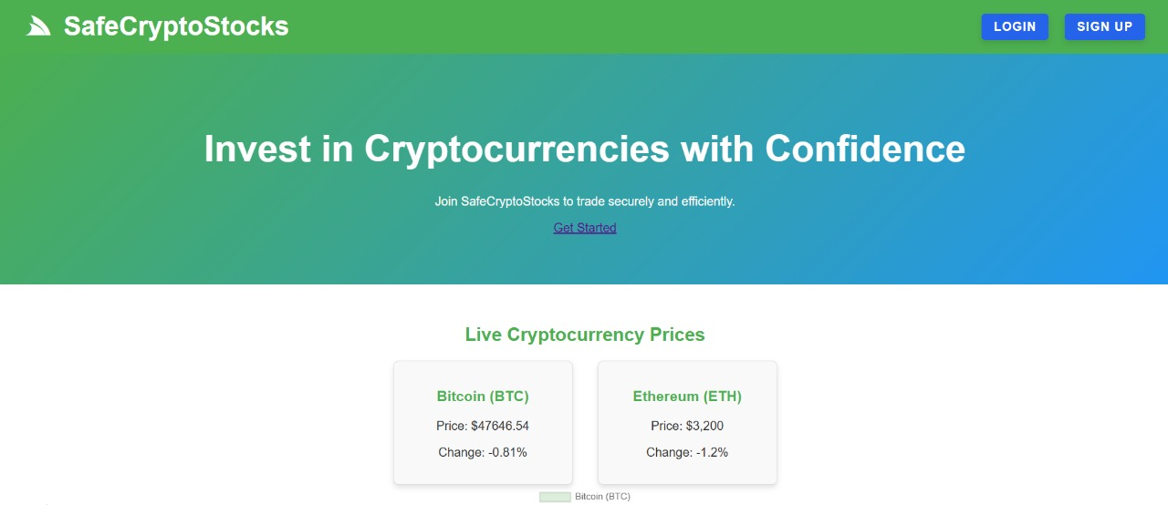
HOME PAGE
Provides an overview of the platform’s features and welcomes users.
Key Features:
Introduction to the platform.
Links to other sections like login or signup.

Slide 6
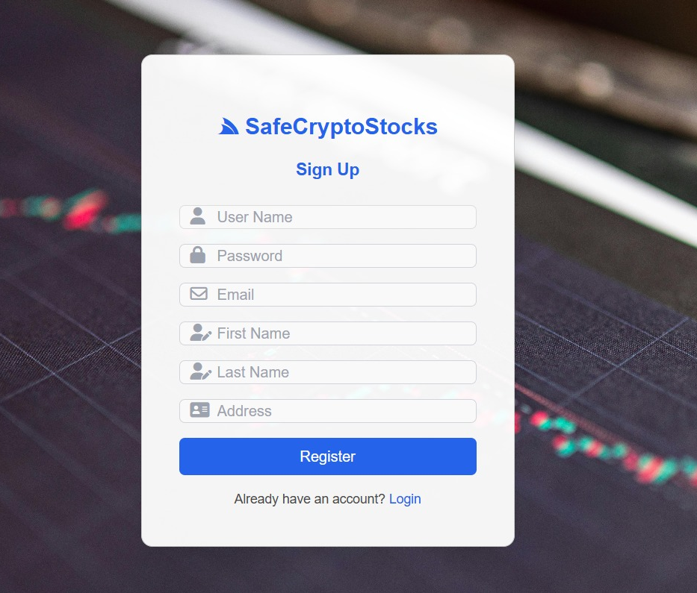
SIGNUP PAGE
Enables new users to register and create accounts
Key Features:
Fields for User Details (name ,email, password).
Email Validation using JavaScript.
Password strength checker.
stores user information securely in the database.

Slide 7
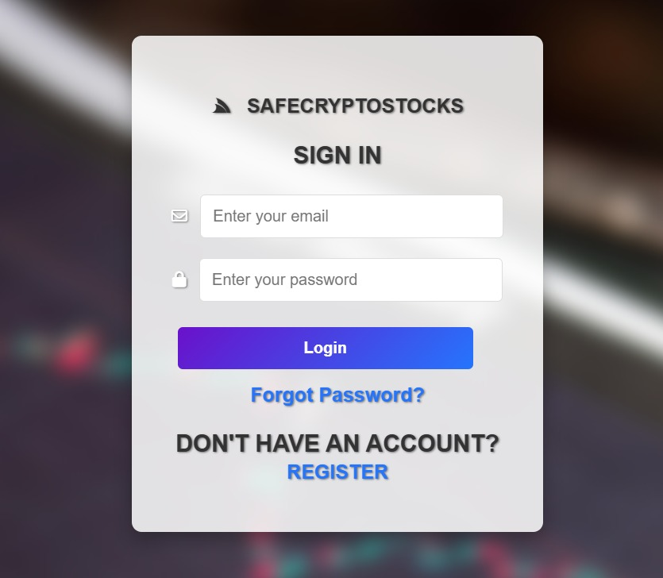
LOGIN PAGE
Allows Users to log in to their \accounts securely.
Key Features:
Username and Password fields.
Login validation using JavaScript.
Error messages for invalid credentials.
Redirects to the dashboard upon successful login.

Slide 8
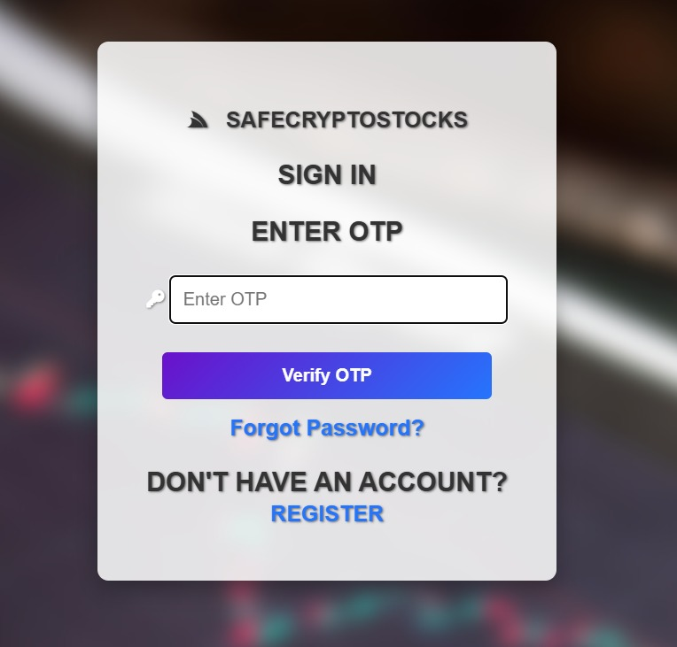
OTP VERIFICATION
Verifies user identity during login using a one-time password(OTP) sent to their registered mail.

Slide 9
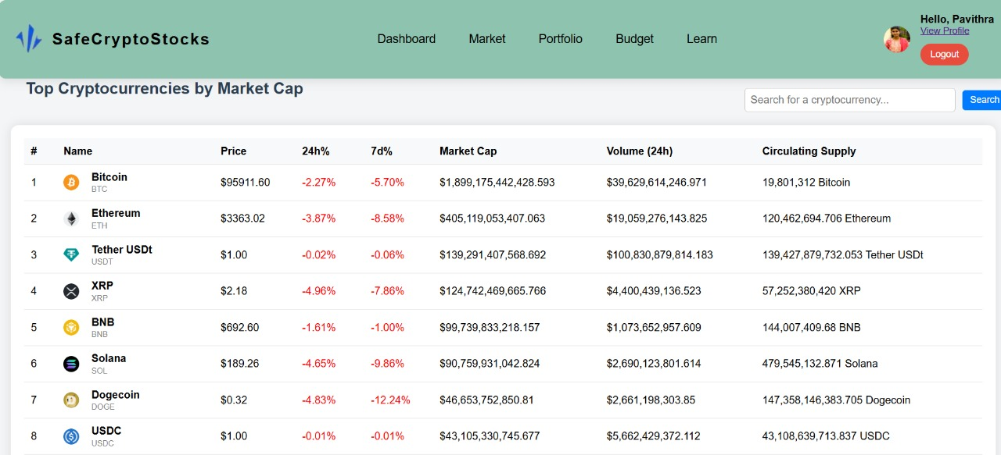
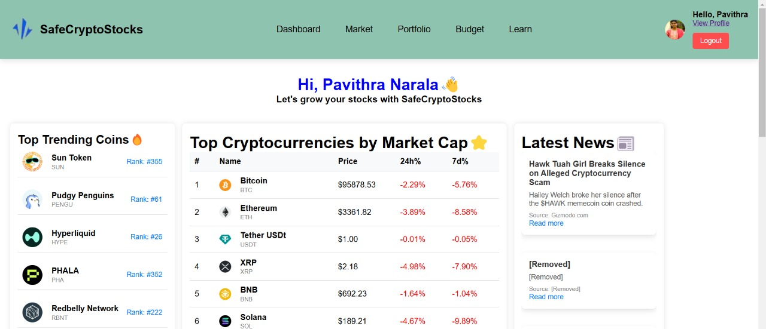
DASHBOARD PAGE
Displays an interactive dashboard with market trends and portfolio insights.
Key Features:
Real-time Crypto currency data updates.
Quick access to portfolio and market analysis.
Dynamic content powered by JavaScript.

Slide 10
MARKET PAGE
Displays real-time cryptocurrency prices and trends to help users track market performance.
Key Features:
Displays a list of cryptocurrencies including their prices , percentage changes and trading volume.
Fetches live data from extrernal APIs for real-time updates.

Slide 11
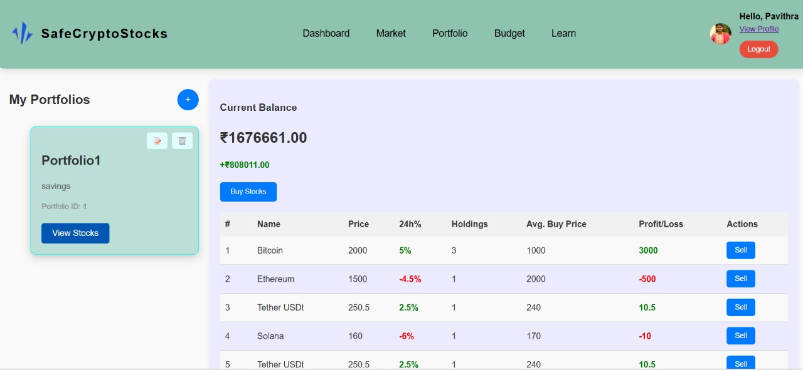
PORTFOLIO PAGE
Helps Users to manage their investments.
Key Features:
Add, Edit or delete stocks in the portfolio.
Displays total investments and profits/losses.
Budget management tools.

Slide 12
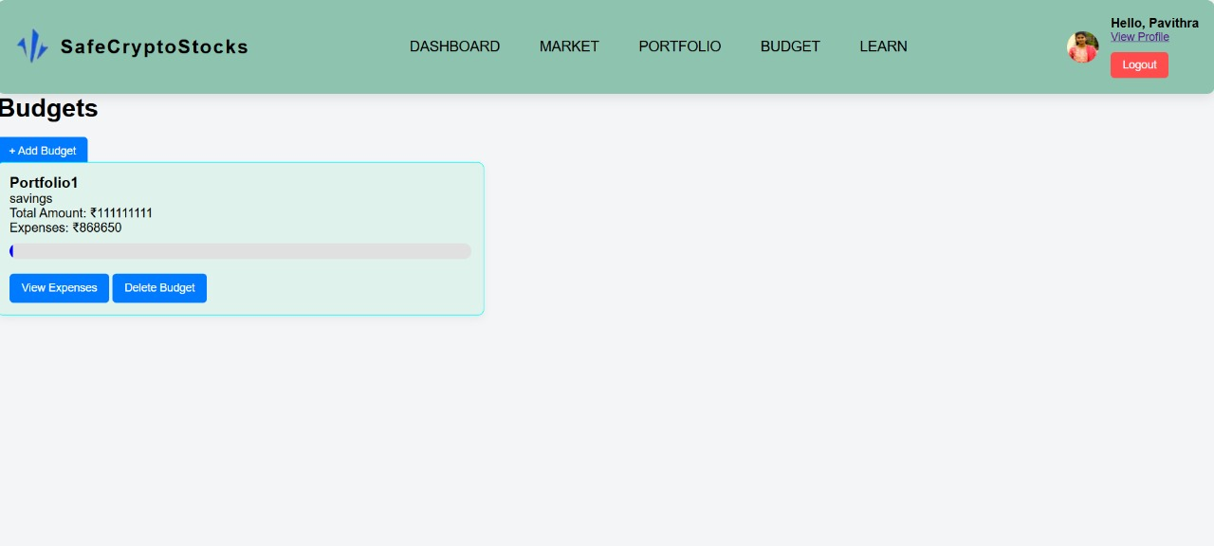
BUDGET PAGE
Provides budgeting tools to track expenses and savings.
Key Features:
Set financial goals and limits.
calculate profits and losses based on market trends.
Interactive visualizations.

Slide 13
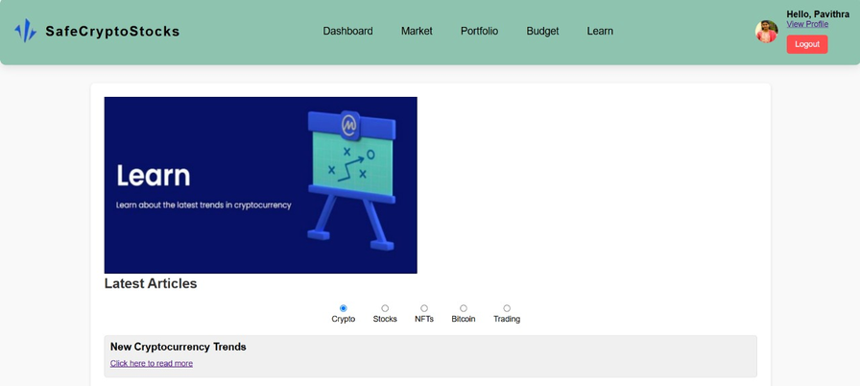
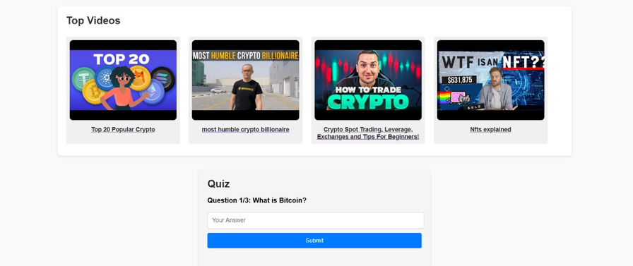
LEARN PAGE
Acts as an educational resource for users to understand investments.
Key Features:
Tutorials and articles about cryptocurrency and investments.
video or infographics explaining market terms.
links to external resources for deeper learning.

Slide 14
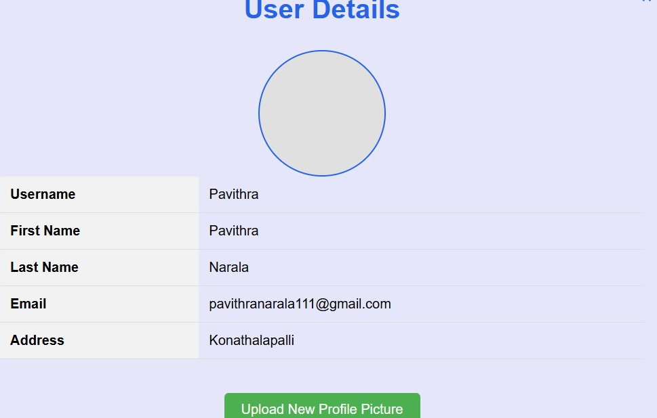
PROFILE PAGE
Displays User profile information.
Key Features:
Shows username , email and account details.
Provides options to edit profile information.
Allows users to logout securely.

Slide 15
1
Frontend: HTML,CSS,JavaScript
Technology Stack
2
Backend:
Java Spring Boot Framework.
3
Database:
MySQL

Slide 16
SYSTEM ARCHITECTURE
Flow Diagram
Final Outcome
Database
SafeCryptoStocks
Web-based platform
Backend
MySQL
Frontend
Springboot
User
HTML/CSS/JS

Slide 17
CONCLUSION
SafeCryptoStocks simplifies cryptocurrency investments with an intuitive interface,real-time market insights, and secure portfolio management. It empowers users to make informed decisions through interactive dashboards and learning resources.

Slide 18



Presented by Team B :
S.Keerthana
K.Ramesh
P.Sreeram
Vishal Kumar
Mahesh
Naveen
Chinmaya Sahoo
N.Pavithra
We extend gratitude to our mentor , Raviteja Sripathi sir for valuable guidance and continuous support.
THANKYOU!

